Slide 1
Successful Strategic Alliances
Simon Pringle, Daniel Phelps, Isaiah Sarria

Slide 2

Article Summary
Learning from successful examples across industries provides valuable insights for businesses looking to leverage partnerships for their own growth.
There are seven examples of very successful alliances and acquisitions highlighted in the article, alongside their key takeaways.

Slide 3
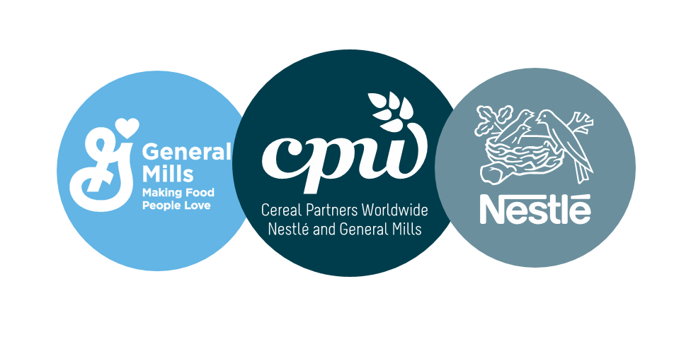
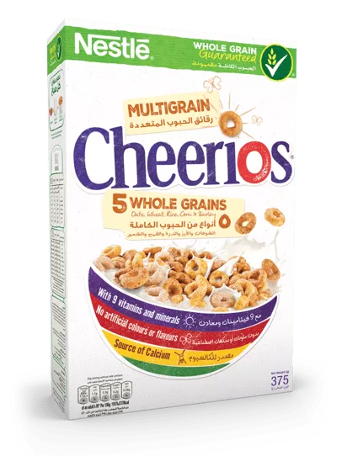
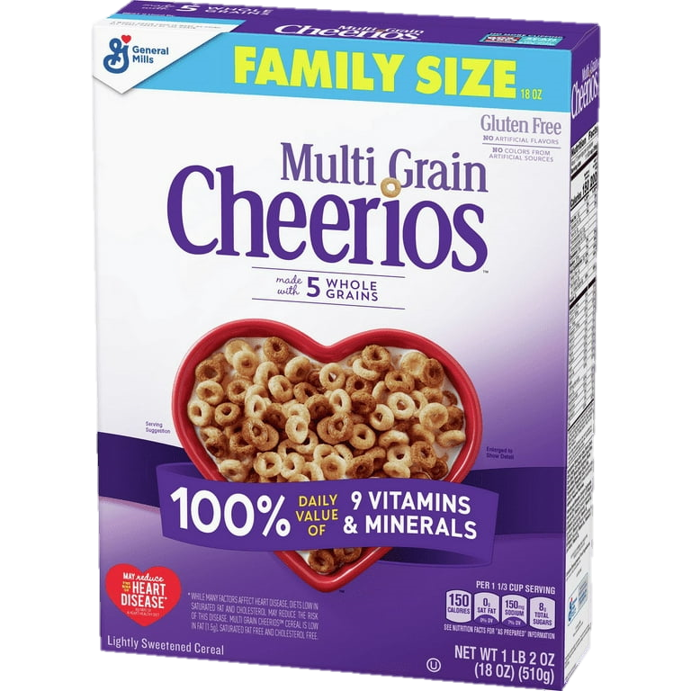
Cereal Partners Worldwide
Joint 50/50 Venture in 1991 to market cereals to 130+ countries besides the US and Canada.
Today, annually turnover $2 billion and employ a workforce of 4,000 employees.
Time-proven venture that is beneficial in an ever-changing and competitive market.

Slide 4

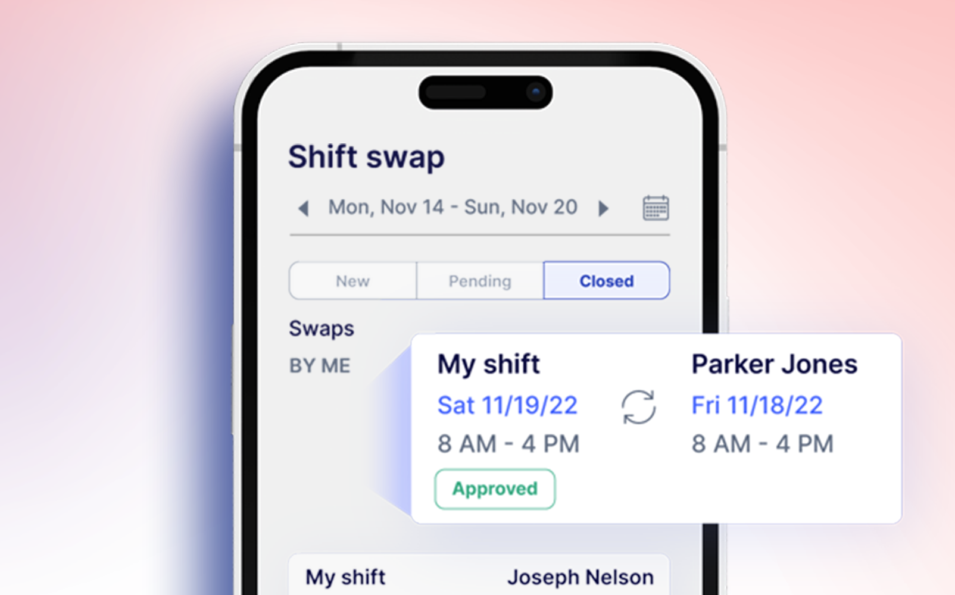
2016 Startup Accelerator
Paired 11 teams with 150 professionals for over 14 weeks with the opportunity to pitch to over 1,000 VC groups.
Successfully incubated several top-notch ideas that received direct investment and pilots on shelves and stores.
Example of how alliances can foster new talent and develop, debut, and promote the next big sensation.

Slide 5
In-Store Service Collaborations
1993
Since 1993, Barnes and Nobles worked with Starbucks
2006
In 2006, J.C. Penny was suffering and coordinated with Sephora
2013
Best Buy and Samsung opened Samsung Experience Shop in 2013
2017
Because of Walgreens’ late hours, in 2017, it served as a convenient location to drop off FedEx packages
Notes:
To serve coffee in their locations as they found their products complemented each other. When a customer reaches for the products of one brand, they can simultaneously reach the product of your brand so its like a snowball effect
Sephora being an outlet location in JC Penny was successful in bringing customers to JC penny during a time of struggle and was a saving grace
Best Buy was dealing with physical media sales going down and big purchases moving online, so Best Buy allocated space for Samsung to demo their product portfolio is stores to bring people in
Another way to bring customers to the store to potentially increase sales by serving a practical need

Slide 6
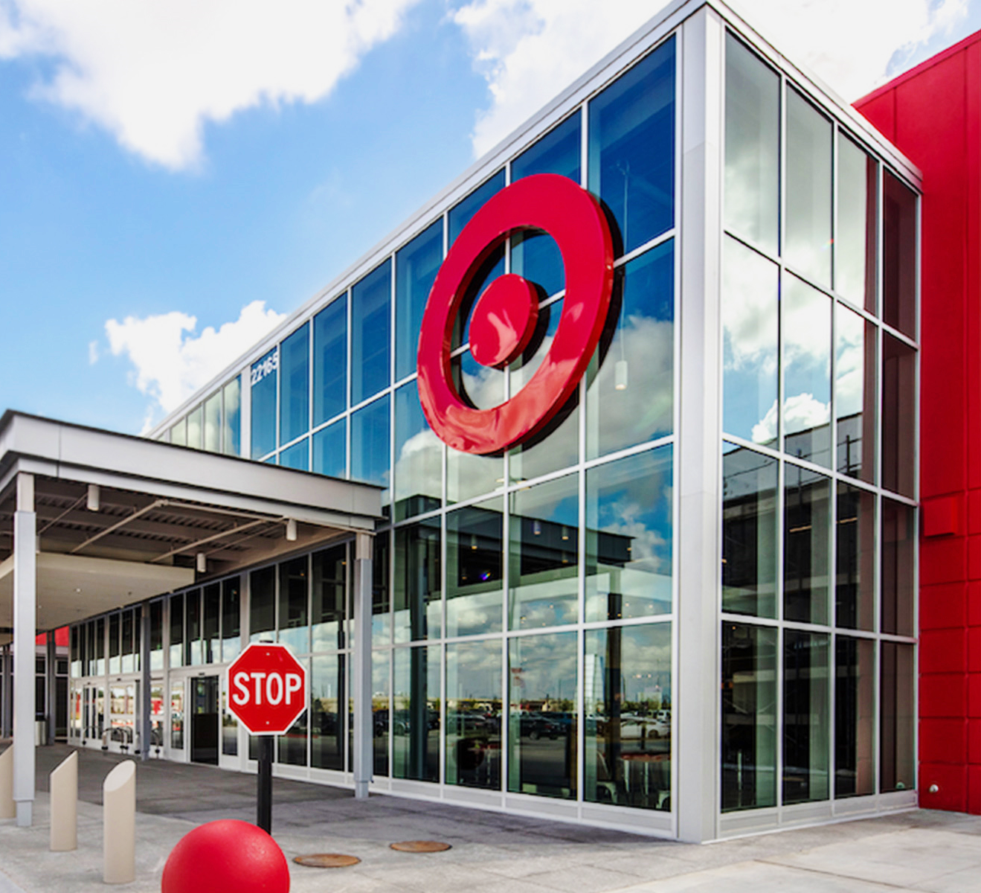
A Leader of Collaboration: Target
Stanley and Starbucks exclusive limited-edition Stanley cup sold only at Target
Multiple designers to sell their apparel and home goods and limited-edition apparel collection tend to be very profitable
Target boosted its retail strategy by teaming up with CVS to manage its underperforming in-house pharmacies.
The previously mentioned alliance with Techstars to mentor startups has continued.

Slide 7

Target + CVS Health
Target boosted its retail strategy by teaming up with CVS to manage its underperforming in-house pharmacies.
Target shoppers can now easily get CVS pharmacy services and healthcare products, which brings in more customers for CVS. Also, CVS customers can check out Target's offerings while at the in-store pharmacies, boosting sales for Target.
CVS has mini-pharmacies in Target stores, drawing in customers who might not have visited a standalone CVS. This brings more people to both Target and CVS, increasing sales for both.

Slide 8
Alliance vs. Partnerships
Partnerships:
Shared business with proportionally shared profits or losses ex. Joint Ventures.
All partners are liable for financial obligations.
Each partner has the authority to act, binding them together.
Partners can often be bought out upon exit, death, bankruptcy, etc.
Alliances:
Mutually beneficial collaboration while remaining independent.
Not liable for another member’s losses.
Alliance members are only bound by the agreement terms.
Alliances can dissolve much easier.

Slide 9
Importance of Strategic Alliances . They Can:
Helps small and medium-sized enterprises (SMEs) access new resources like technology, capital, and expertise they might not be able to develop on their own.
Expand into new markets by teaming up with a company already established there.
Boost innovation through idea and resource sharing, fostering new products, services, and processes.
Cut costs by sharing resources and expenses, ultimately enhancing profitability for both parties.

Slide 10
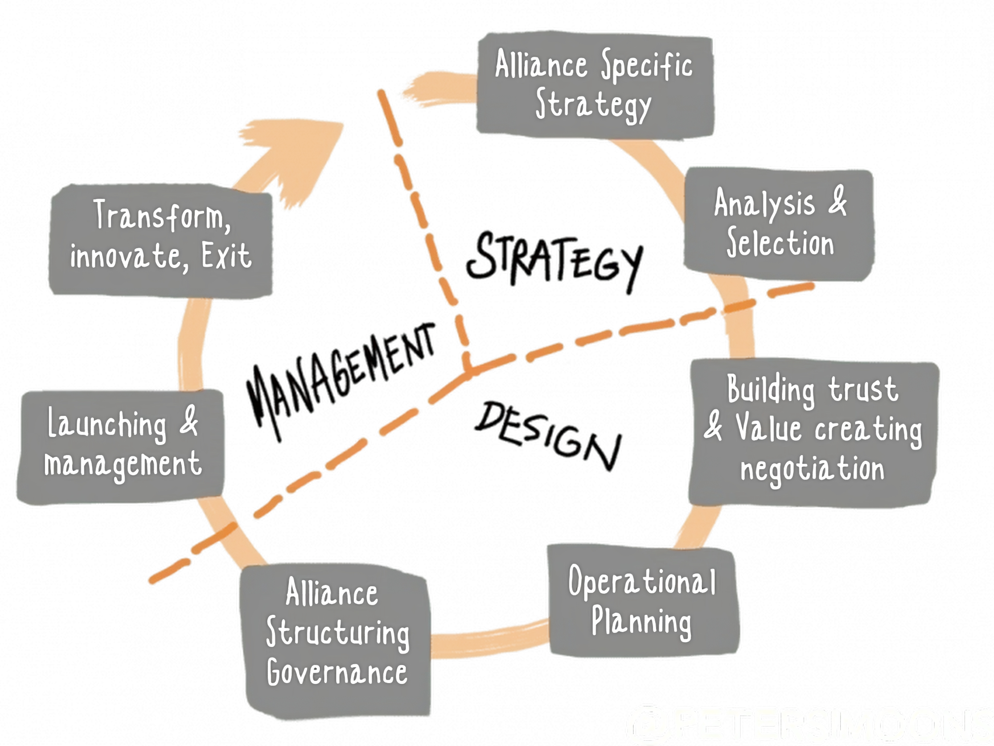
The Alliance Life Cycle
The median life span for alliances is only about seven years, and nearly 80% of joint ventures ultimately end in a sale by one of the partners.
The length of the cycle is different for every company, but most stages in Strategy and Design range from 4-6 weeks.

Slide 11
How to Form/Manage Strategic Alliances
Select partners that match your company's culture, values, and business objectives.
Define alliance goals clearly.
Establish a governance structure detailing each partner's roles and responsibilities.

Slide 12
How to Form/Manage Strategic Alliances
Set up good communication and coordination methods.
Resolve conflicts promptly and peacefully.
Regularly assess and review the alliance to ensure it stays on track.

Slide 13
Failed Alliances
Heinz and McDonald’s
Kraft and Starbucks
LEGO and Shell

Slide 14
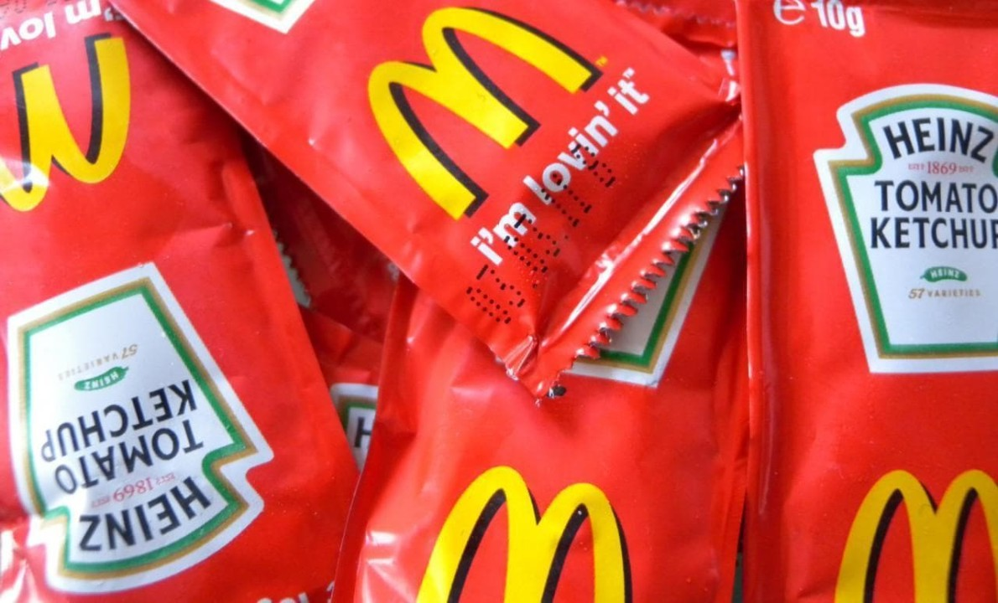
Heinz and McDonald’s
Worked together from 1973-2013
All overseas McDonald’s ketchup and ketchups packets were Heinz
In 2013, Heinz took on Bernardo Hees as CEO
Hees had a successful 4-year CEO tenure at…

Slide 15
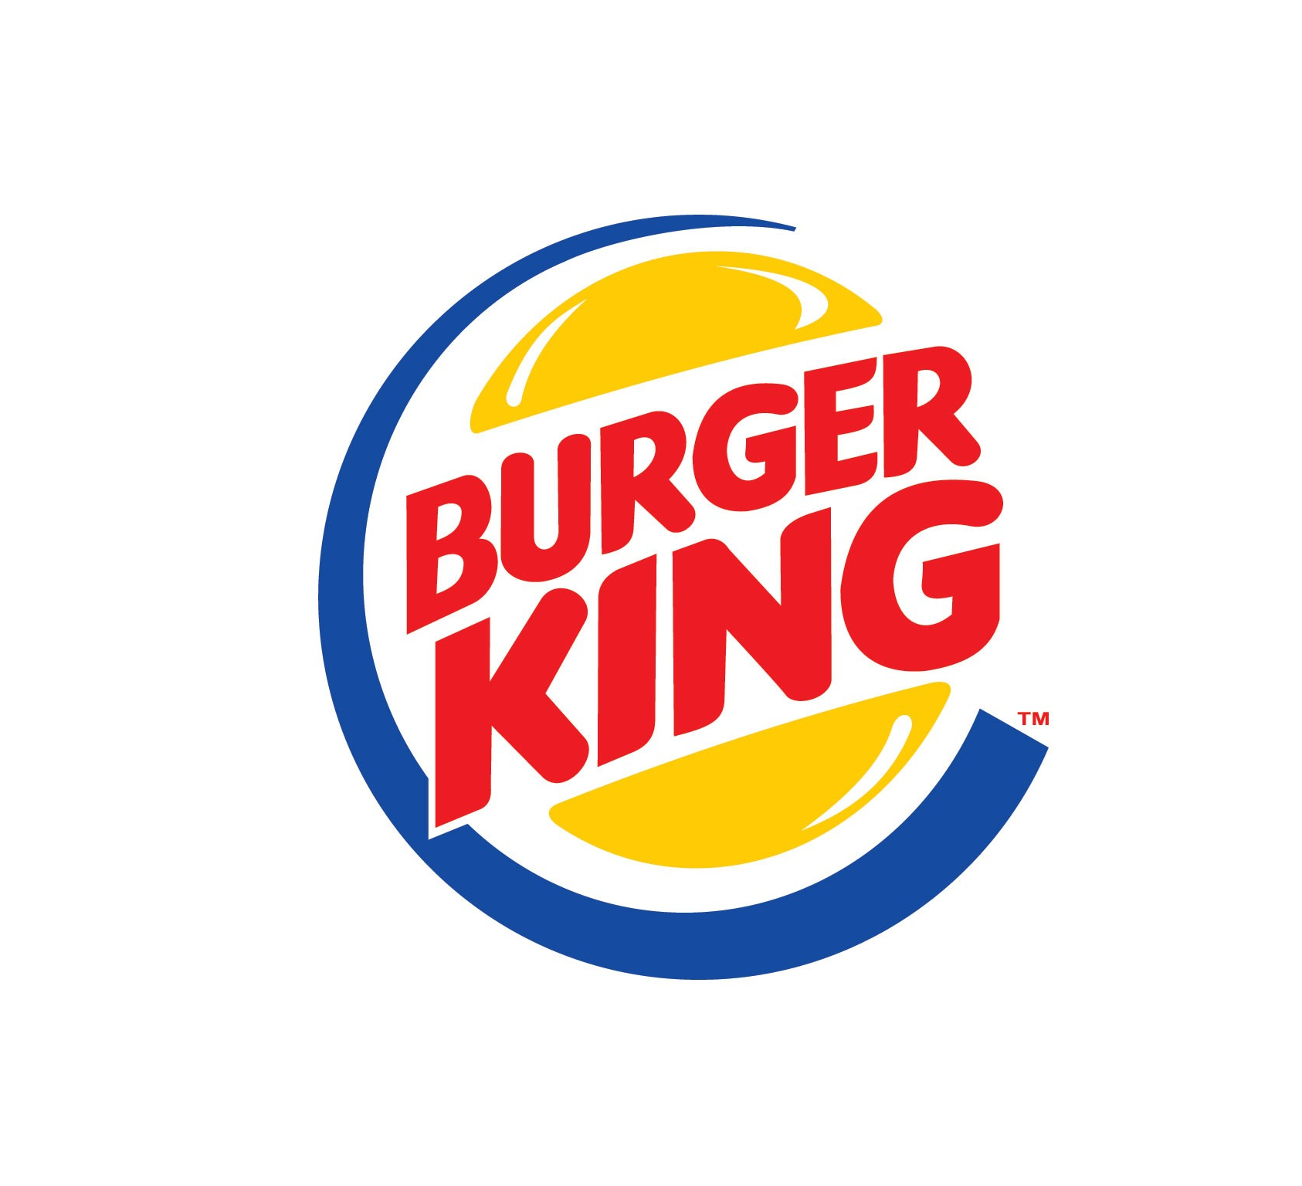
Hees successfully rivaled McDonald’s for four years
Hees was still a BK board member and could be exposed to data
If ketchup demand increases BK might predict a new ketchup-related menu item

Slide 16
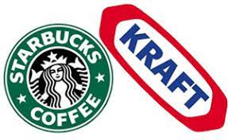
Kraft and Starbucks
Collaborated from 1998-2011
Kraft marketed and distributed Starbucks coffee.
Starbucks wanted to start selling coffee pods which is outside of Kraft deal because they didn’t package coffee pods.
Starbucks tried ending contract early, and offered $750M

Slide 17
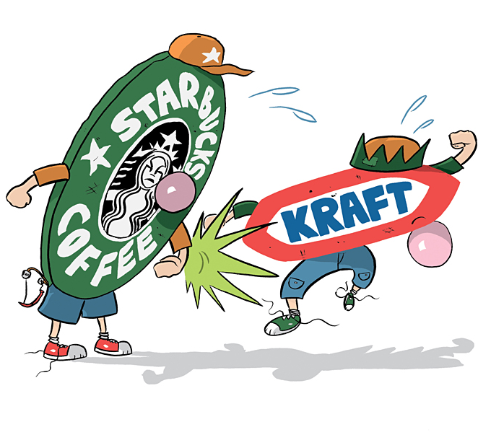
Kraft refused as per contract
Starbucks decided to distribute their own coffee pods
Kraft accused Starbucks of breaching the contract and Starbucks accused Kraft of mismanaging the brand
Arbitrator forced Starbucks to pay $2.7B
Notes:
Contract said one who initiates breakup must pay market value of shared assets

Slide 18
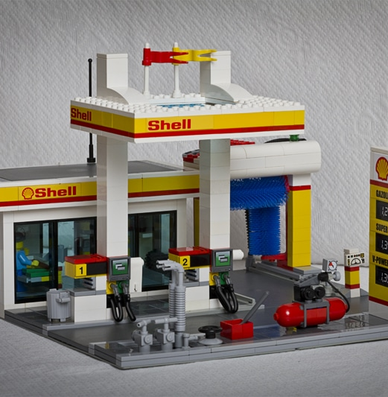
Lego and Shell
Successful from 1960-2011
Great marketing and relationship
Alliance starting getting under fire from environmentalists
To end bad rumors, partnership ended
Notes:
Shell had questionable environmental practices with high carbon emissions and accused the partnership of being a PR strategy

Slide 19
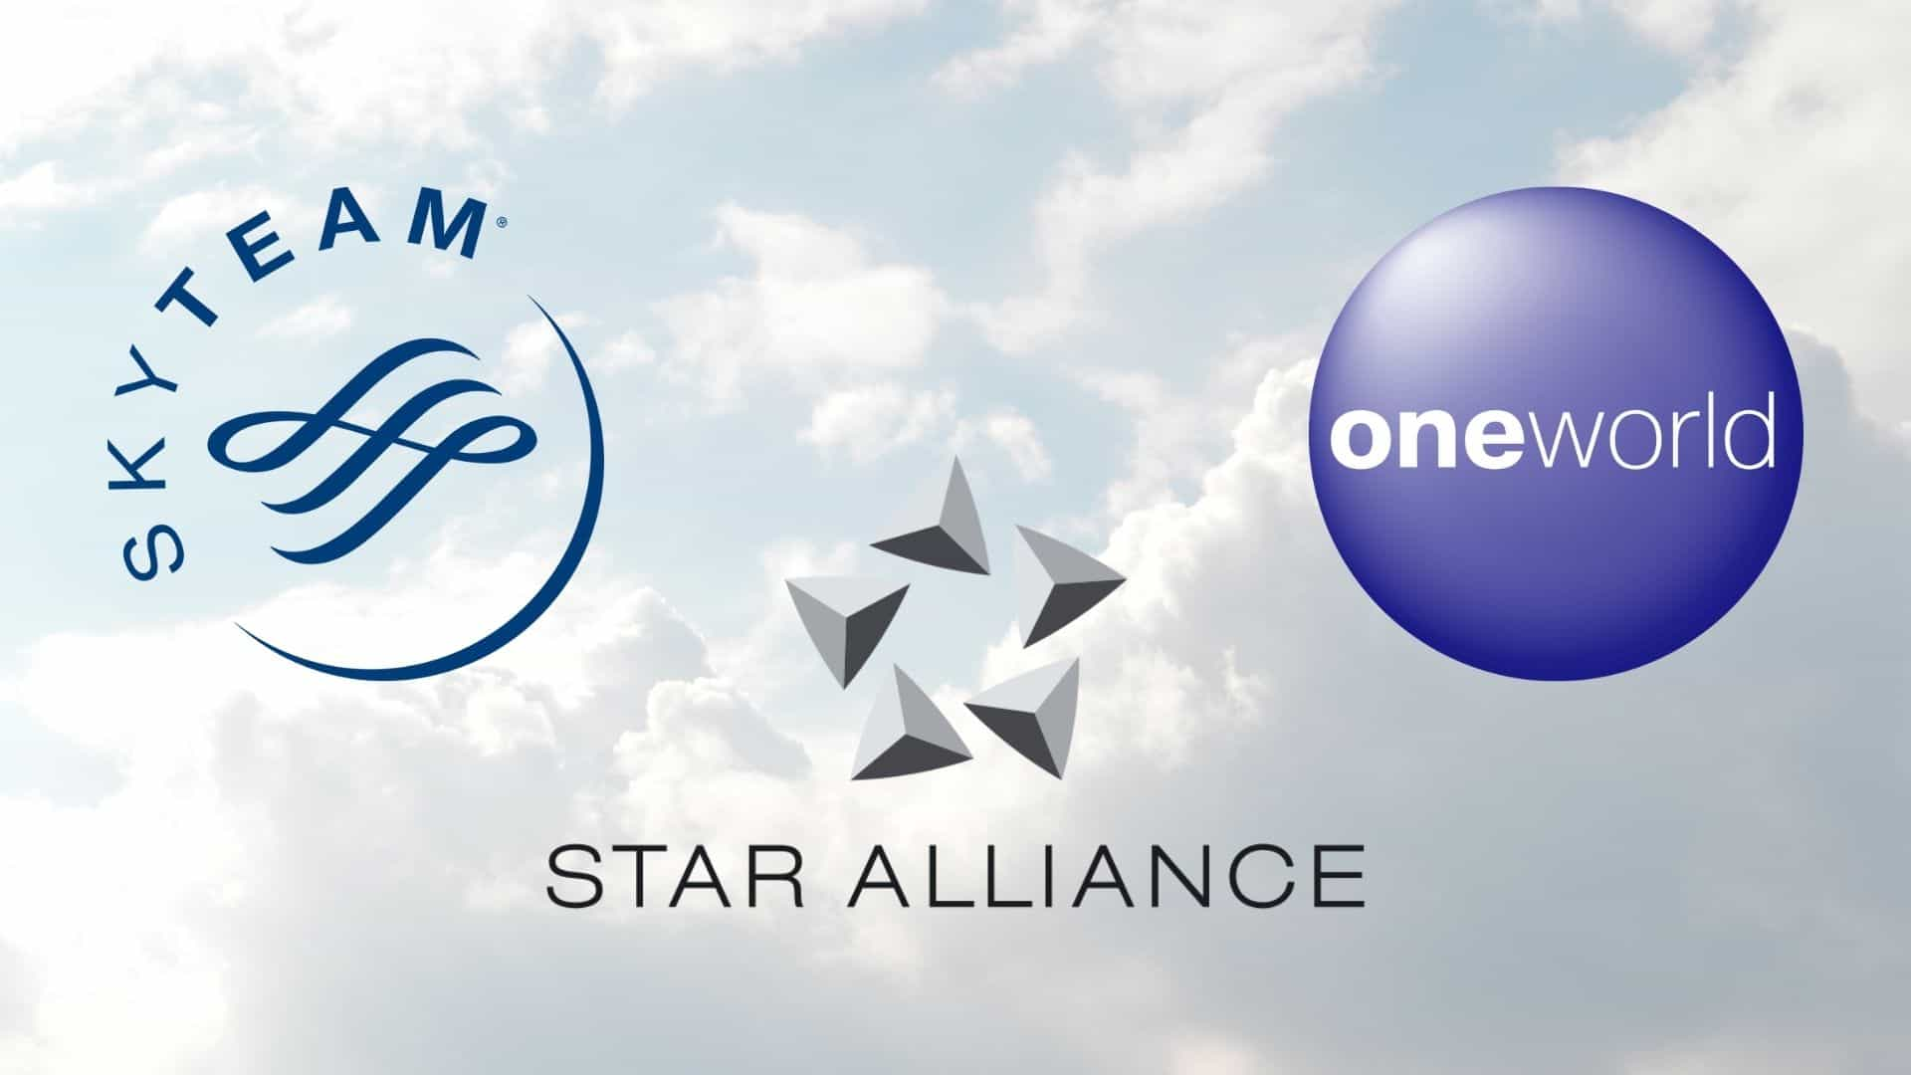

Retail vs. Transportation Alliances
Retail alliances primarily center around improving inventory management, customer experience, and market reach.
Transportation alliances concentrate on optimizing logistics, transportation networks, and delivery processes to enhance the movement of goods across the supply chain while reducing cost.
Two industries previous students used were the Airline Industry and International Shipping Industry

Slide 20
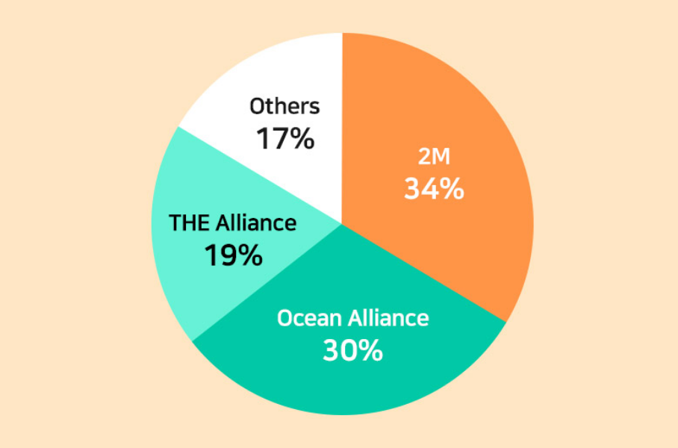
Unknown Costs of Alliances
Besides just publicly revealed costs, both successful and failed alliances can cost millions in management, training, rebranding, and legal fees.
For the Airline Alliances, members must provide value to join, but any fees are non-disclosed.
The 2M Alliance will be disbanded in 2025, potentially costing each of the companies a significant amount in market share and oligopoly price.

Slide 21

Costs of Failed Alliances
McDonald’s was only using Heinz overseas, which will hinder Heinz greatly as 60% of their business is overseas.
Starbucks was forced to pay $2.7 billion to Kraft in their contract disagreements.
The cancelled Lego and Shell alliance was valued at $116 million, based off its prior distribution of 16M sets across 26 countries.

Slide 22

Costs of Greenmail Alliances
In 1996, Apple was financially suffering and was down 80% of it’s prior market value.
A major competitor at the time, Sun Microsystems, sought to acquire the company through a stock swap valuing Apple at just $5-6 per share.
In 1997 with Steve Jobs back as CEO, a $150 million investment by Microsoft in Apple effectively blocked any attempt of acquiring a controlling interest in Apple.

Slide 23
Costs of Successful Alliances
Largely non-disclosed unless companies partnered through an acquisition: CVS buying Target’s in-store pharmacies for $1.9 Billion.
Cereal Partners Worldwide – Both GM and Nestle provided the JV with their branding, marketing, and technology at no cost. Any equipment, distribution systems, or product was invoiced at cost basis.
Starbuck’s on the other-hand uses a licensing fee model costing partners an unknown fee, with $4.5 billion generated from 18,258 locations in fiscal year 2023. (~$246,000 per location)

Slide 24
Daniel’s Opinion
Unlocking Growth through Strategic Alliances
In today's dynamic consumer landscape, strategic alliances are essential for staying competitive and meeting evolving customer needs.
Strategic alliances enable quick responses to market shifts or threats by adjusting partnerships and reallocating resources.
Collaborating with reputable partners strengthens brand image and credibility, enhancing customer trust.

Slide 25
Simon’s Opinion
Unlocking Growth through Strategic Alliances
Strategic alliances offer unparalleled advantages for businesses seeking growth and expansion that outweigh the costs.
It allows them to expand beyond their current scale and scope to even enter new markets.
I think that a major factor in the success is the strategy phase- picking a clear goal and an ally that can make it happen.

Slide 26
Isaiah’s Opinion
Unlocking Growth through Strategic Alliances
Alliances who work together to go beyond their own capabilities can unlock new markets and customers.
Alliances perform well with complementary goods and services.
Respecting and communicating relevant plans with the ally is crucial.

Slide 27

Questions?

Slide 28
References
www.allbound.com/wp-content/uploads/2018/12/ebook-7_Successful_Strategic_Alliances-7_Updated.pdf.
www.strategic-alliances.org/alliance-life-cycle.
africafeeds.com/2019/10/14/avoiding-mistakes-top-corporations-that-failed-in-partnership/.
www.linkedin.com/pulse/strategic-alliances-key-success-todays-globalized-economy-yadav/.
https://www.reuters.com/article/idUSBRE9AB17A/#:~:text=Kraft%20began%20marketing%20and%20distributing,to%20privately%20held%20Acosta%20Inc.
https://www.sec.gov/Archives/edgar/data/40704/000089710101500527/gm012987-ex10_16.txt
https://www.pon.harvard.edu/daily/business-negotiations/the-starbucks-kraft-dispute-in-business-negotiations-prepare-for-problems/#:~:text=In%202010%2C%20with%20sales%20of,the%20market%20at%20the%20time.
https://scrippsnews.com/stories/how-greenpeace-forced-a-lego-shell-breakup/#:~:text=Greenpeace%20believed%20Lego%20was%20putting,can%20get%20away%20with%20it.
https://www.businesswire.com/news/home/20130424006543/en/Samsung-and-Best-Buy-Begin-Nationwide-Rollout-of-Samsung-Experience-Shops
https://www.modernretail.co/marketing/retailers-like-target-are-jumping-at-the-chance-to-collaborate-with-stanley/
https://www.forbes.com/sites/gracelwilliams/2021/03/20/hunter-lilly-pulitzer--more-some-of-targets-coolest-collaborations/?sh=5249bb9d5179https://www.forbes.com/sites/gracelwilliams/2021/03/20/hunter-lilly-pulitzer--more-some-of-targets-coolest-collaborations/?sh=5249bb9d5179

